Slide 1
E-Commerce-Online Shopping Mart
Project Partner Name:- 1.Rohit Gurav ( Roll No.223066)
2.Rohan Mahale( Roll No.223105)

Slide 2
What is E-Commerce?
E-Commerce commonly known as online platform source. It consist of buying and selling product and services over an application systems Such as the internet and other computer as well as mobile phone networks.
E-Commerce allows people to do business without the constraint of distance and time.

Slide 3
Benefits of E-commerce website
Convenience Easiness
Keep track consumers Buying Habit
Efficient and competence
Easy to sell Products Across the World
Stay open 24hrs/365days
More economical and reasonable.
Reduce Costs
Expand Market for niche products

Slide 4
Technologies
Backend :Spring Boot
Database : MySQL
User Interface Design : React-js
Web Browser : Mozilla, Google Chrome,

Slide 5
Module
home module
Registration module
Login /Signup module
Cart module

Slide 6
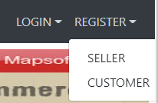
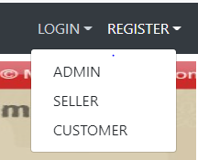
Registration
Seller Role
Customer Role
Login
Admin Role
Seller Role
Customer Role

Slide 7
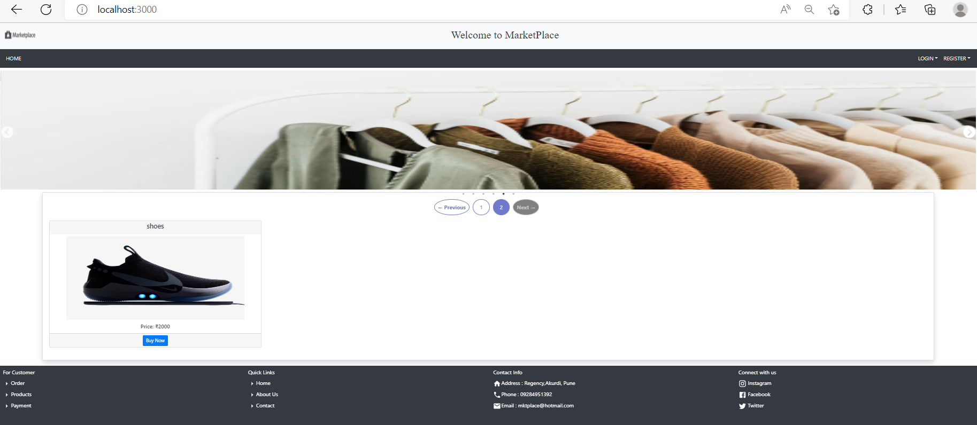
Home Page

Slide 8
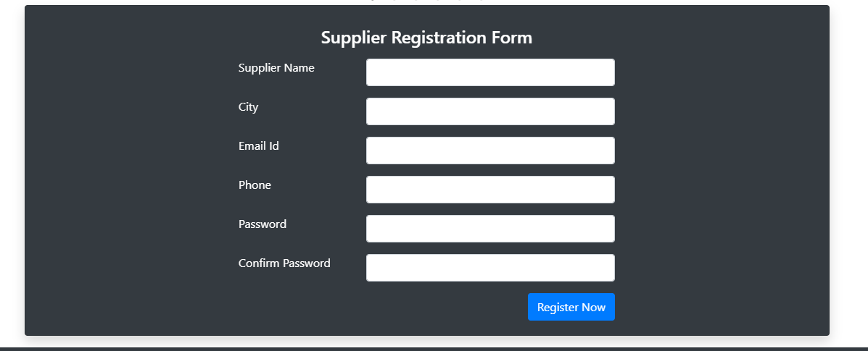
Seller Registration From

Slide 9
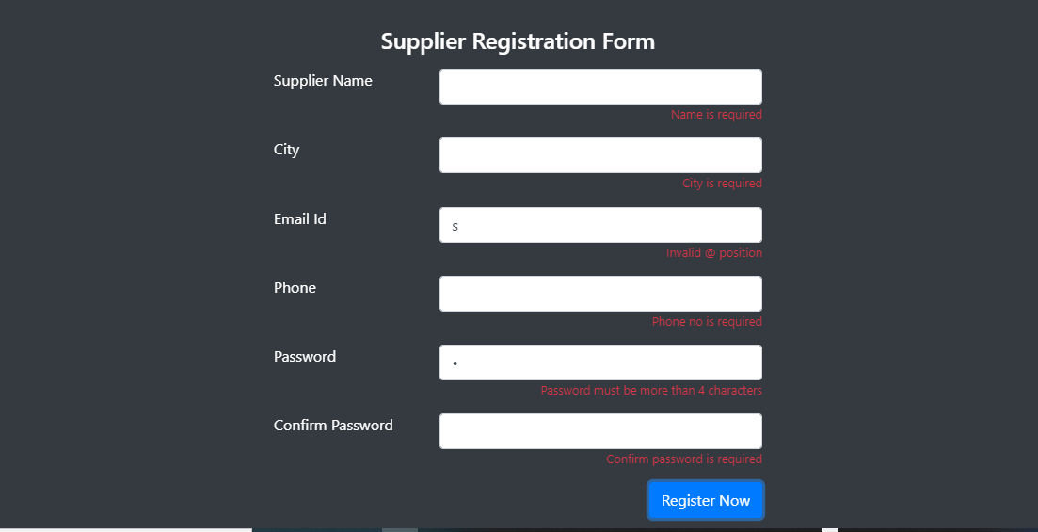
Supplier validation from

Slide 10


Seller login details

Slide 11
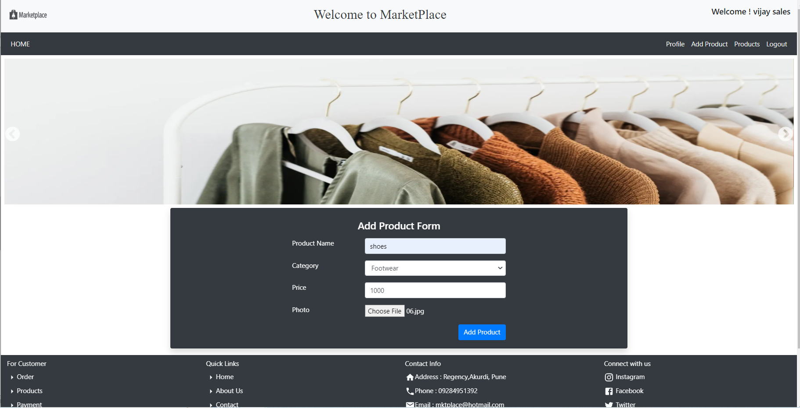
Seller add products details

Slide 12
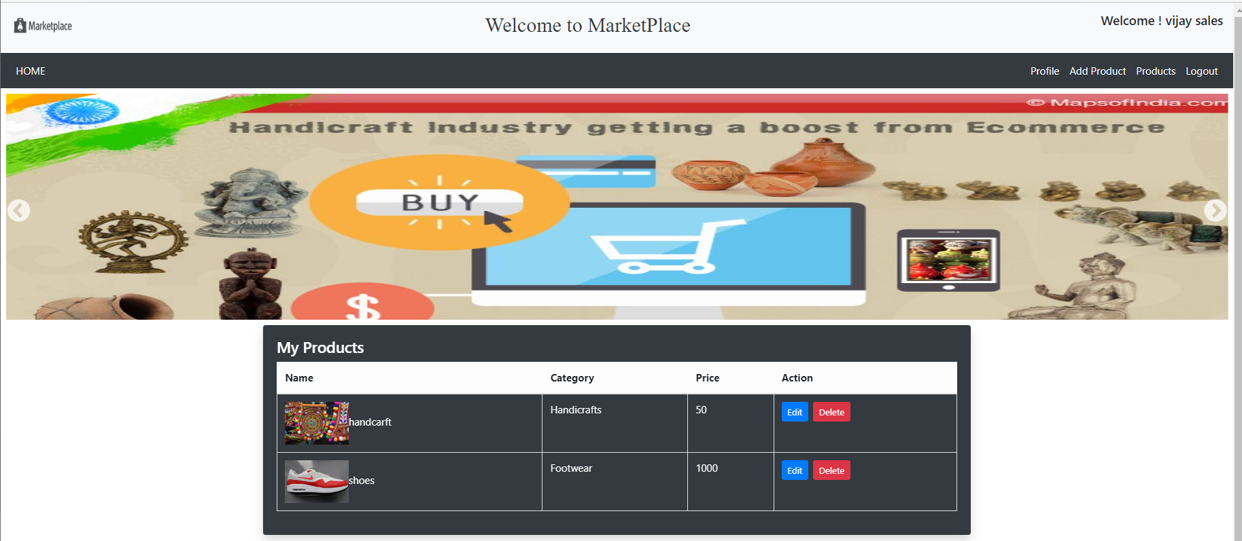
Sellers product list

Slide 13
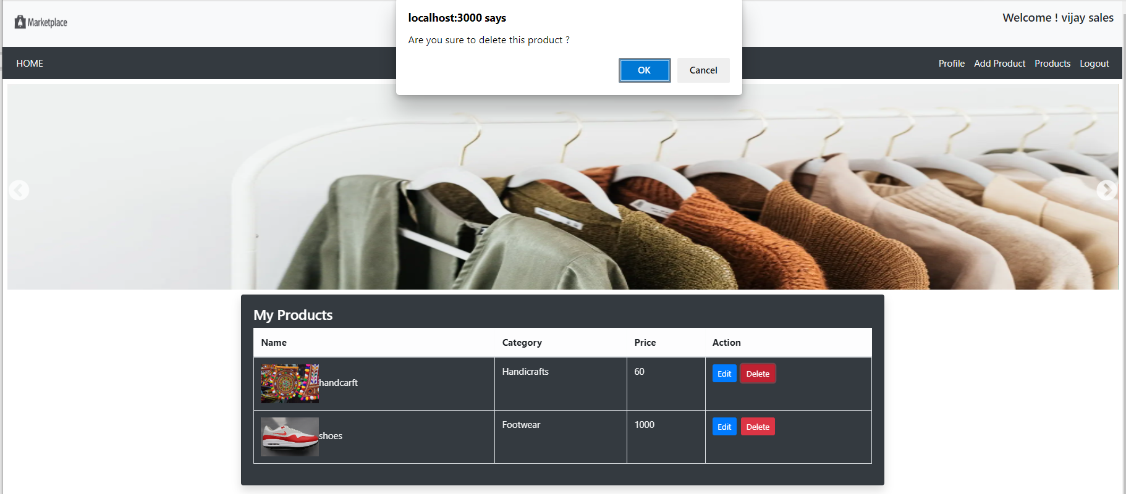
Seller product delete

Slide 14
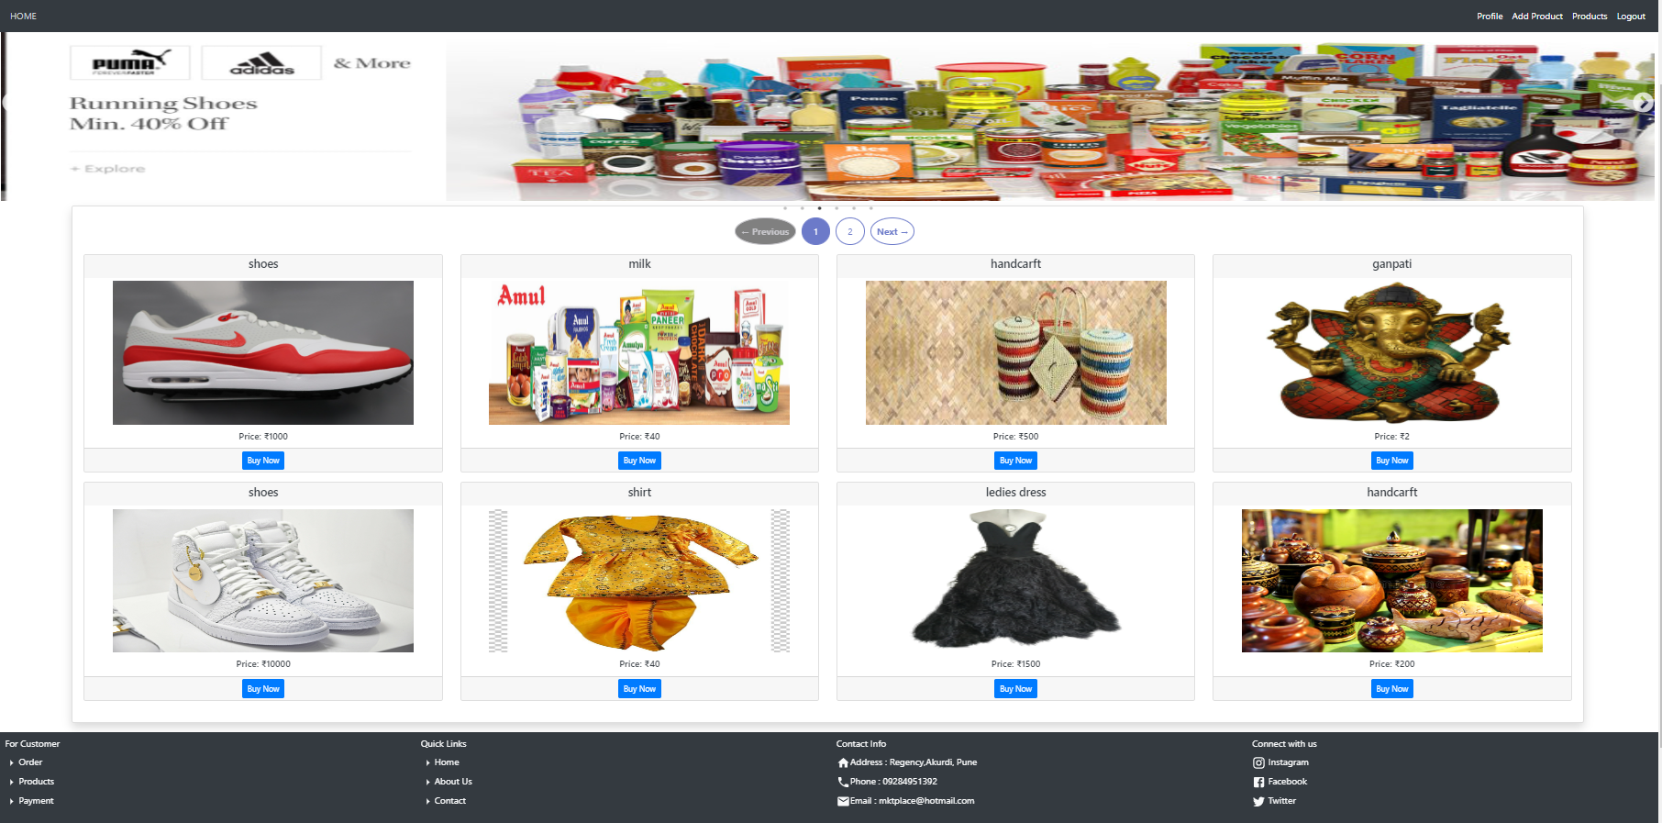
Sellers added products

Slide 15
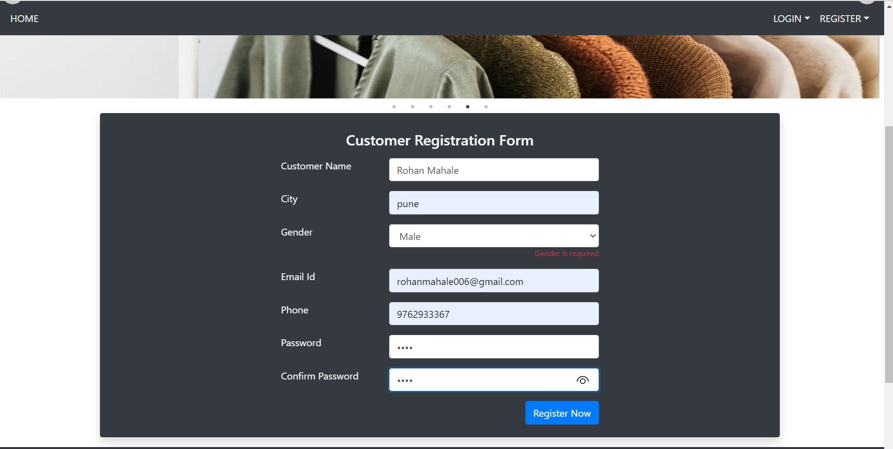
Customer registration form

Slide 16
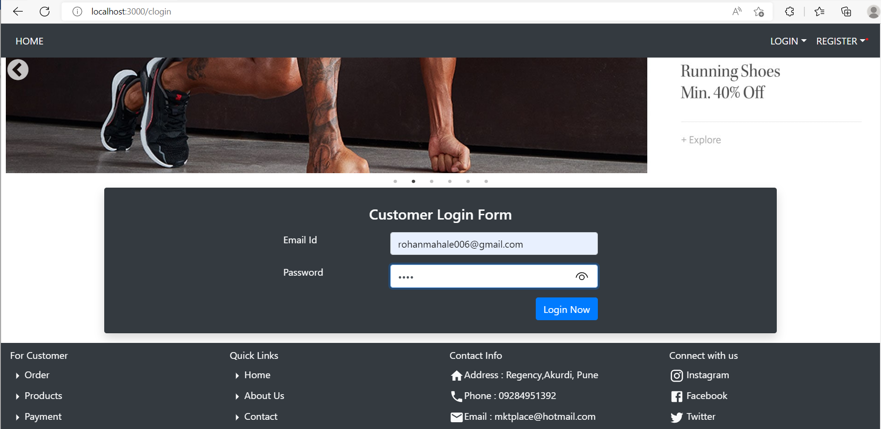
Customer Login Page

Slide 17
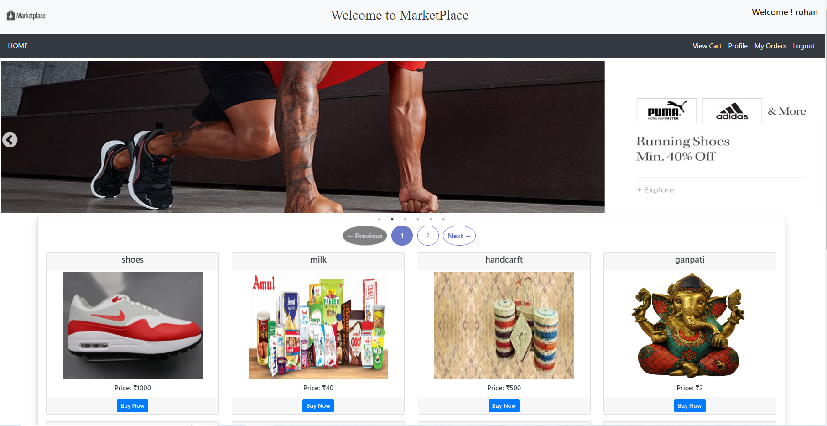
After Login Customer Home Page

Slide 18
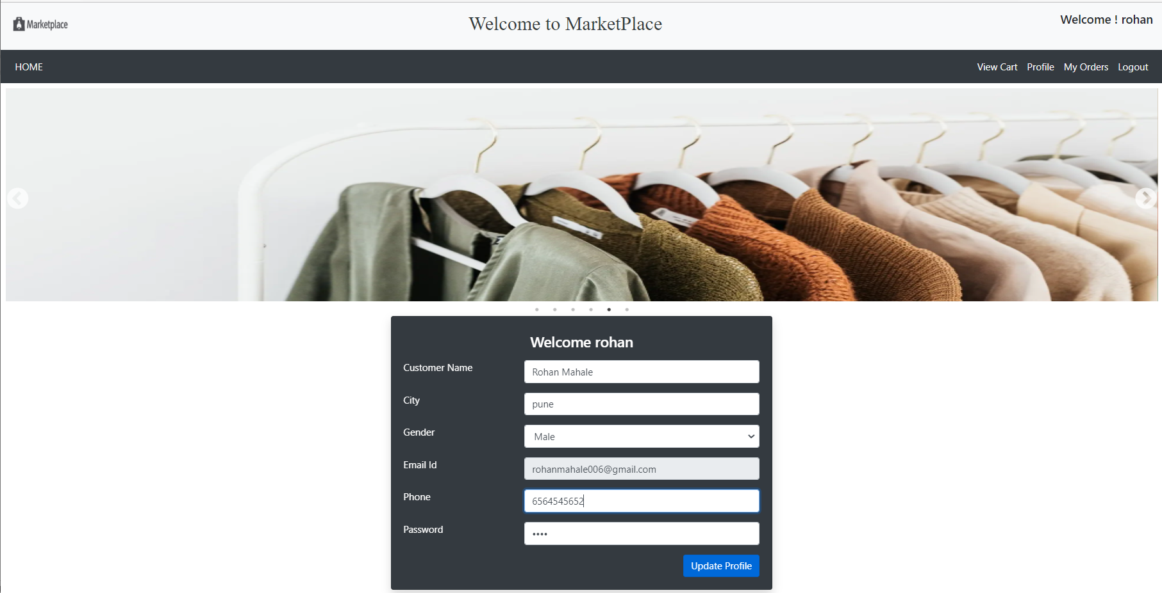
Customer update form

Slide 19
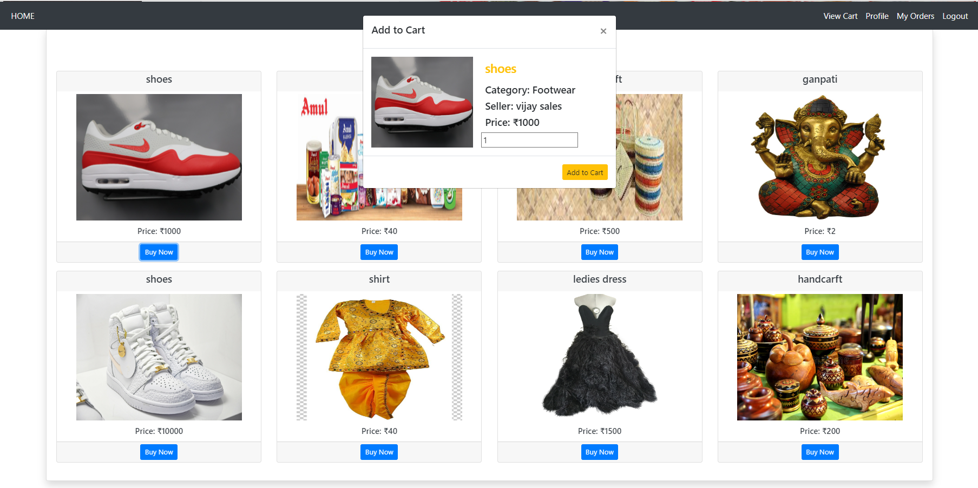
Customer buy a product

Slide 20
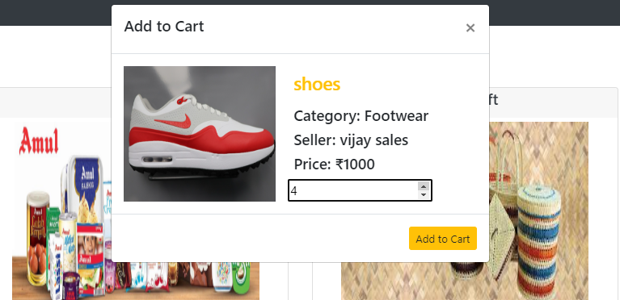
Customer buy a product and set a quantity

Slide 21
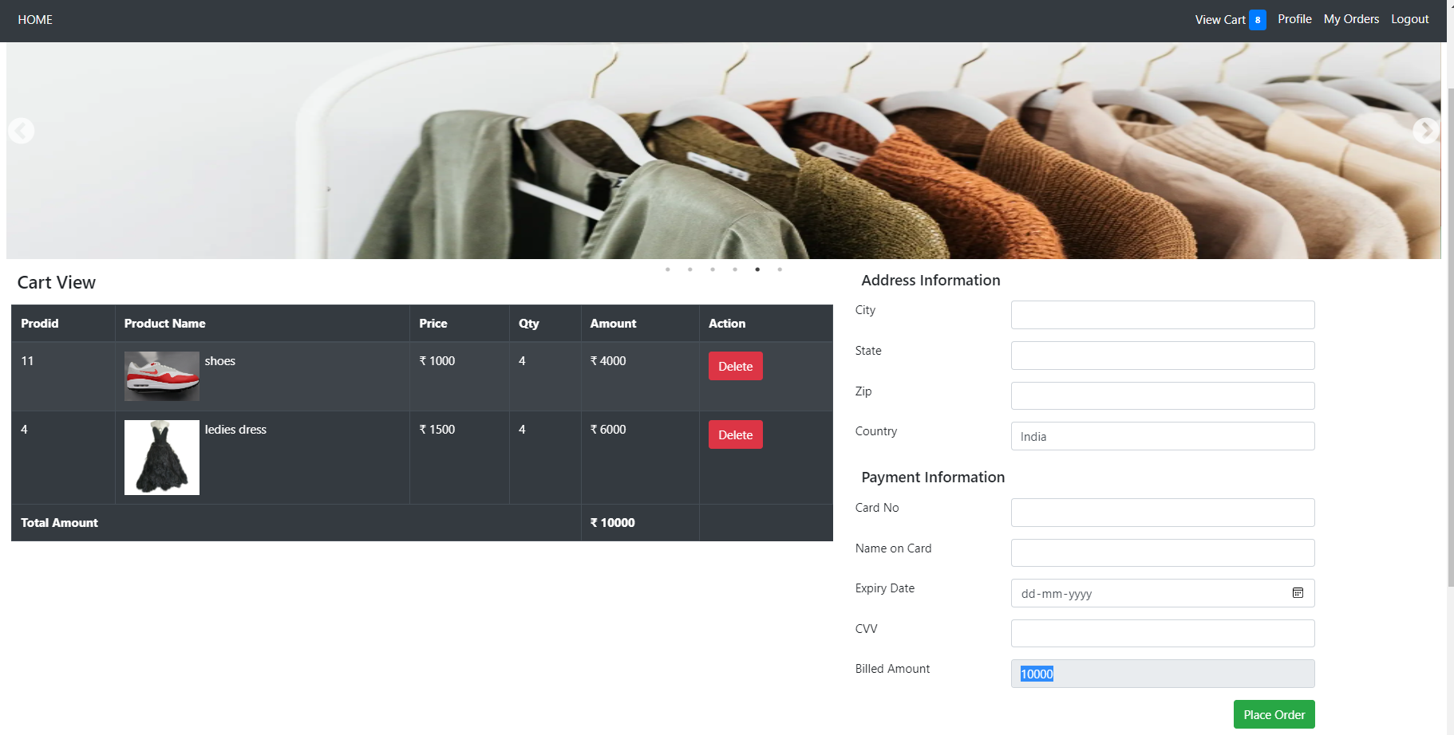
Customer View cart page

Slide 22
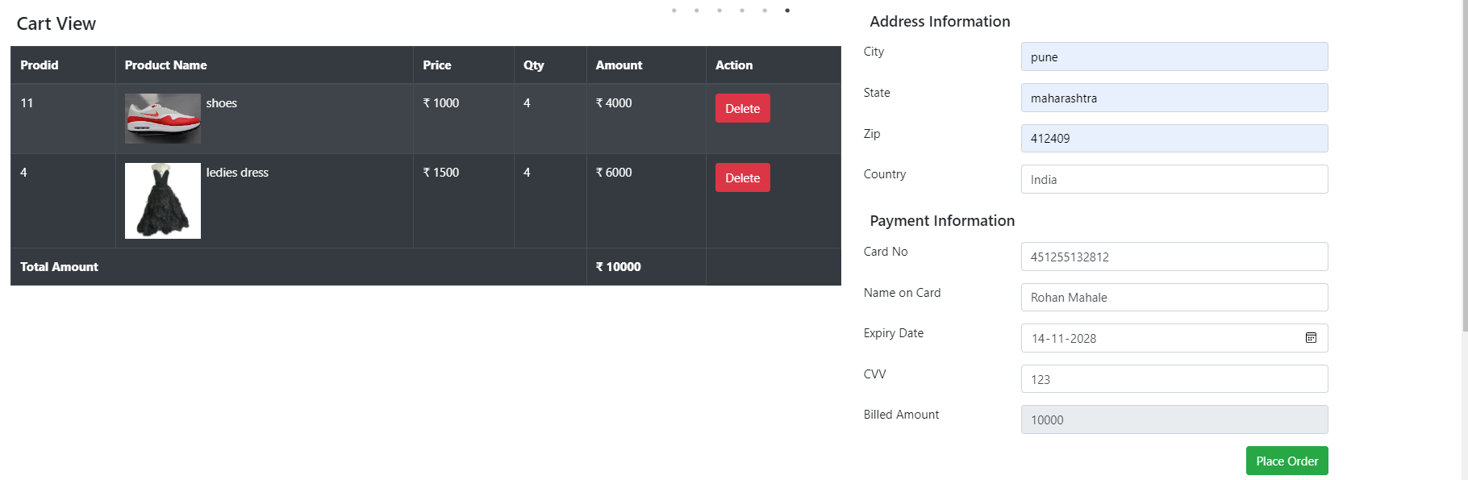
Customer address details and payment form

Slide 23
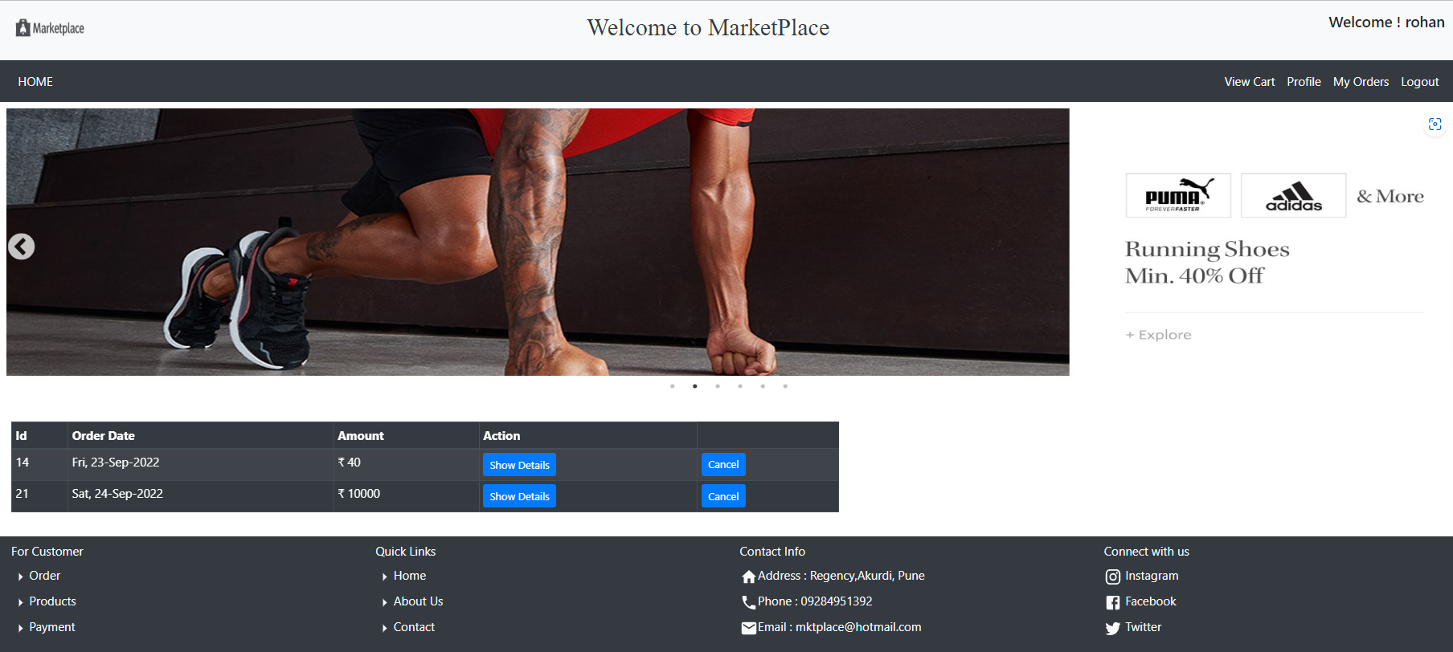
Customer’s Order Page

Slide 24
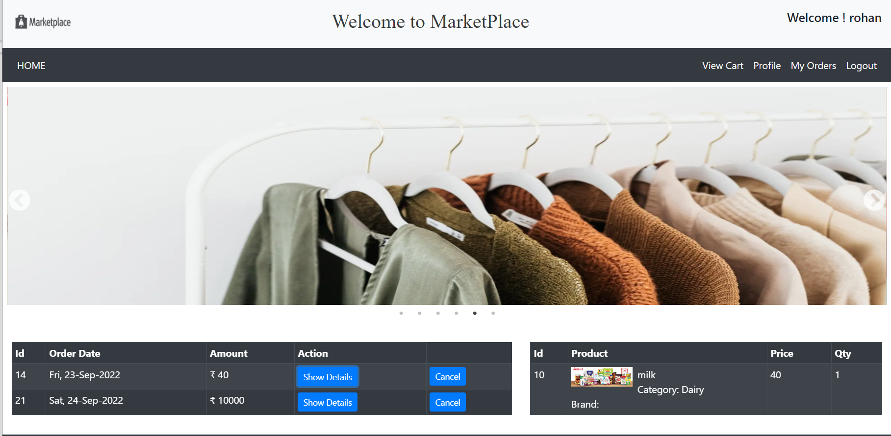
Customer’s show the specific product order details

Slide 25
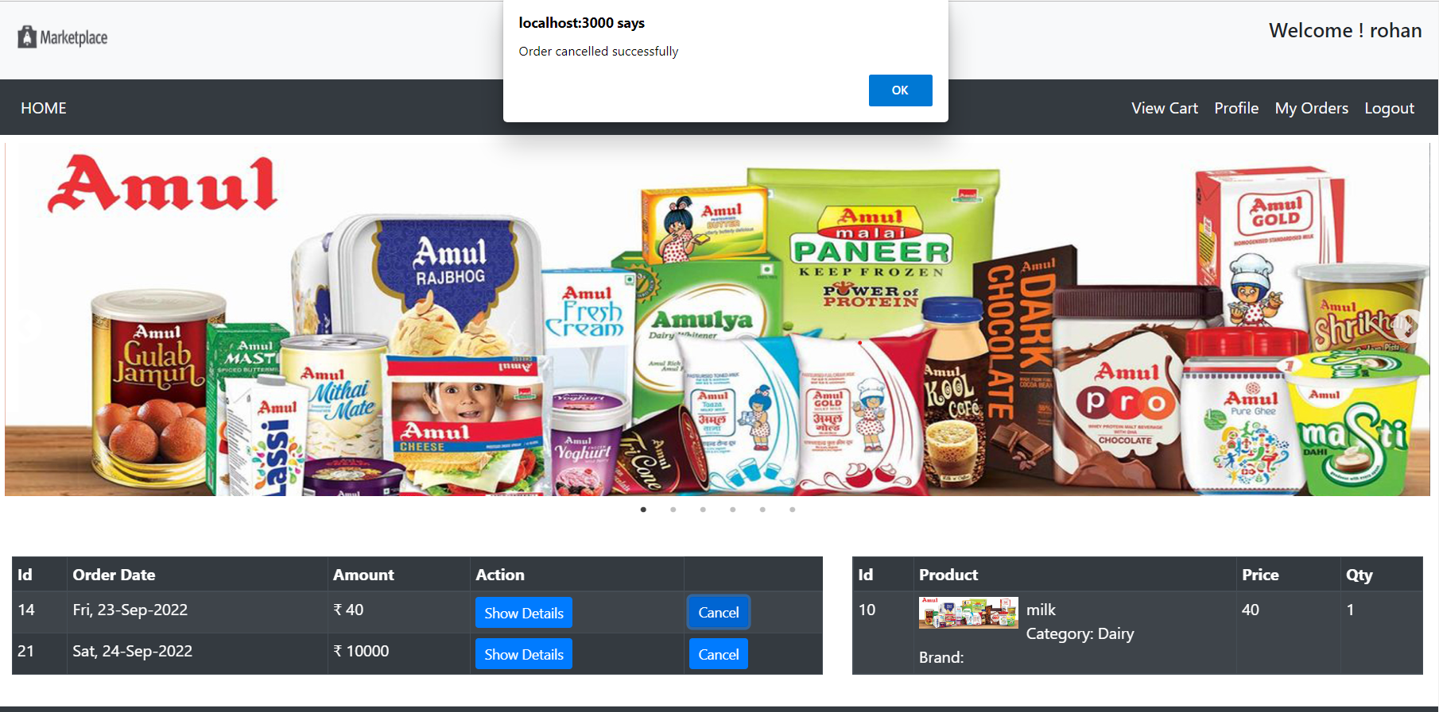
Customer Order cancellation

Slide 26
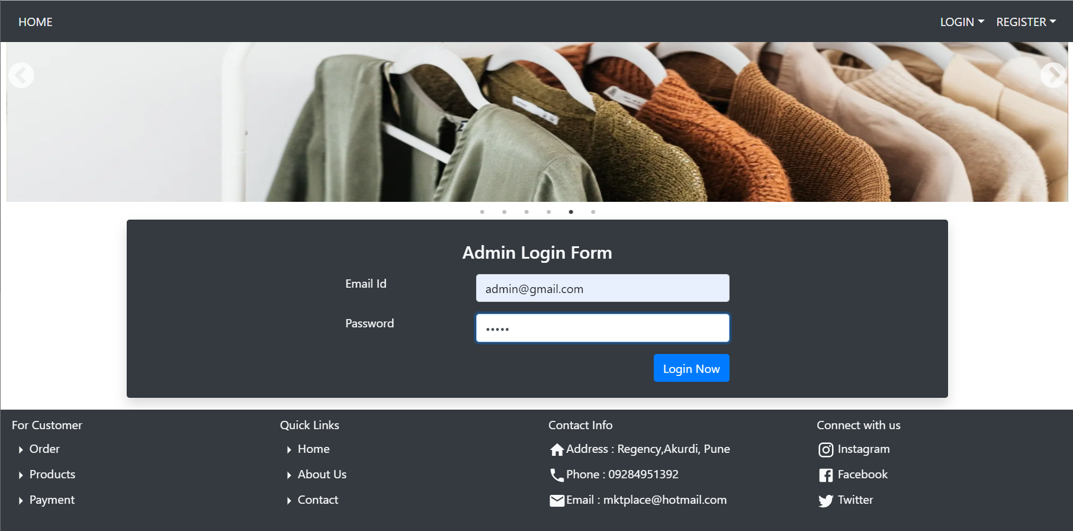
Admin login page

Slide 27
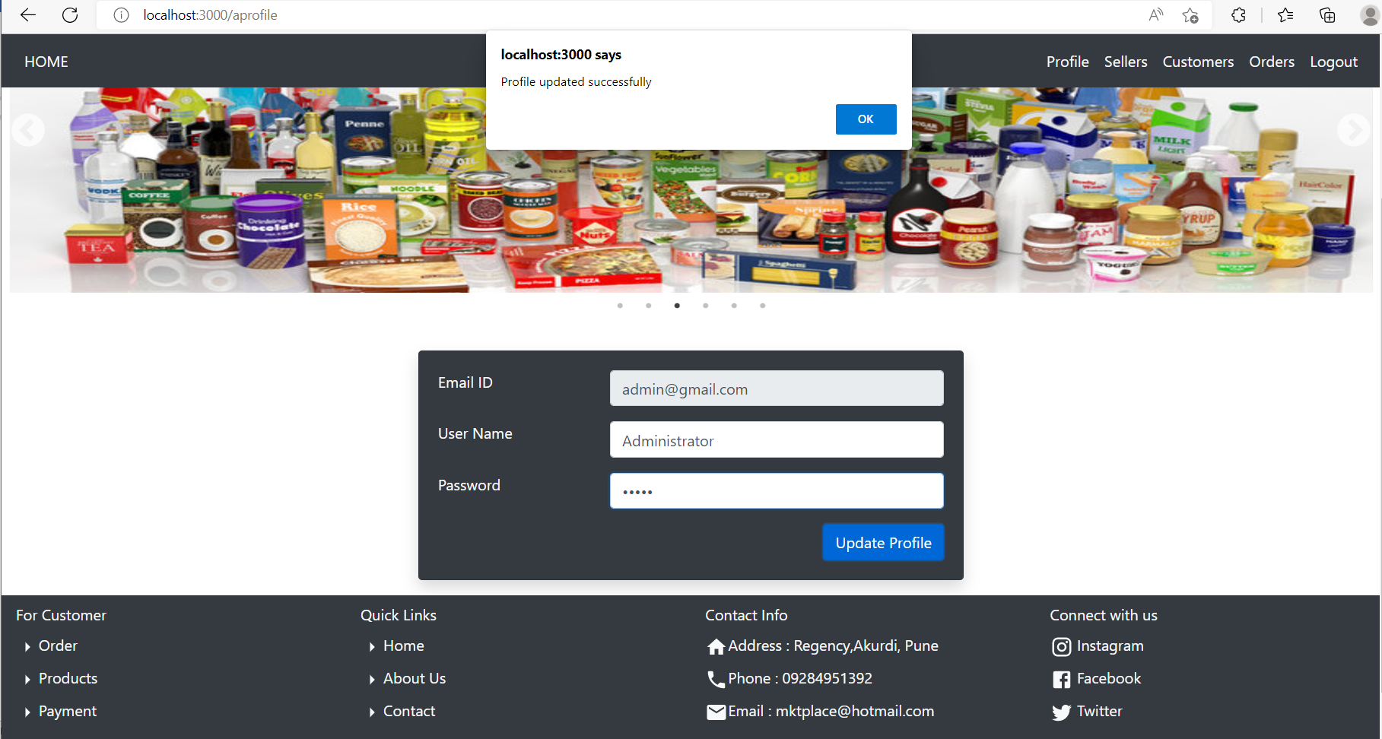
Admin update profile

Slide 28
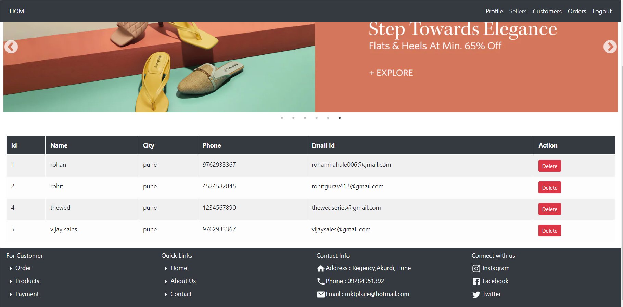
Admin show the seller details

Slide 29
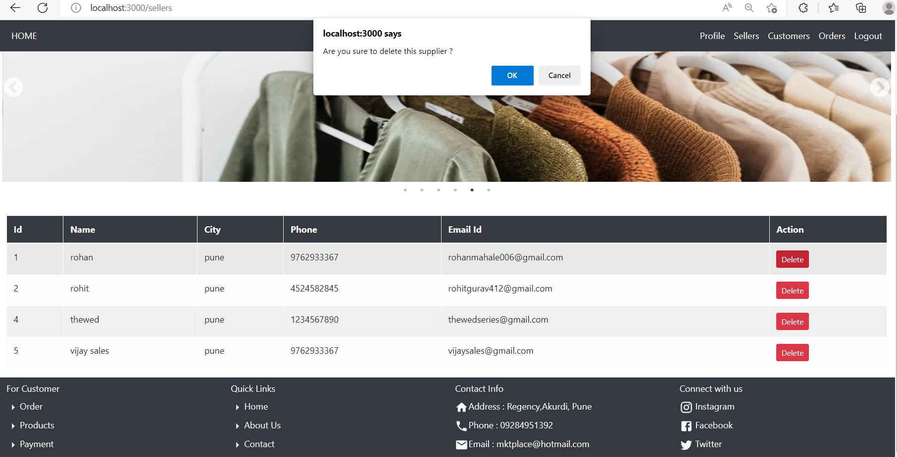
Admin delete seller

Slide 30
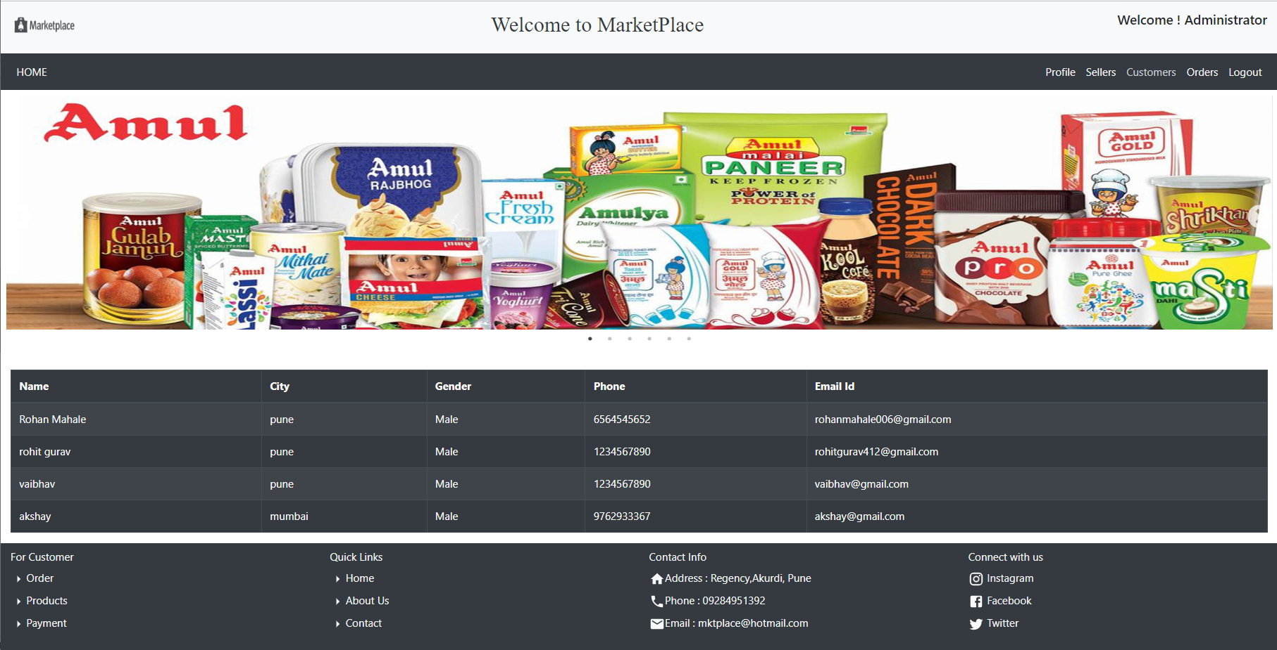
Admin view the all customers details

Slide 31
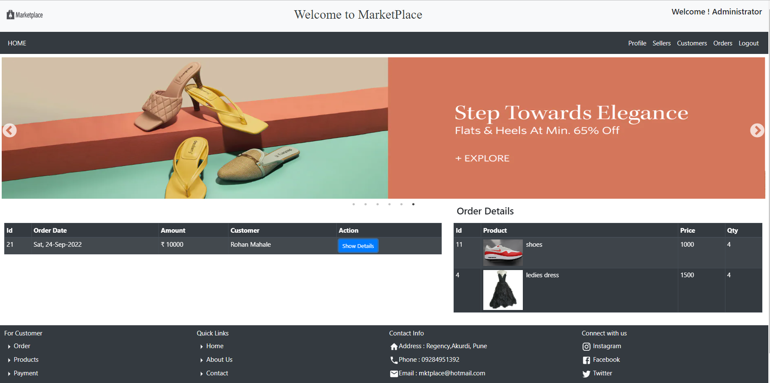
Admin view the total orders

Slide 32
Home page

Slide 33
Thank You ..!!!!

